Slide 1
Team Name: Tentative 2 Problem statement: B
Names of Team Members :
Aia Al Mansori, Thelma Ofoegbu, Aishat Yusuff, Maya Niessen,
Disclaimer – The timings for each slides are indicative. Students can distribute the total time of 5 mins according to their pace, ensuring they cover contents for each of the slide. The titles for the slides will be the same as in the template provided.
Notes:
The Title of this project is 'Head and Neck Cancer Dataset' with a focus on constructing meaningful Datasets for predicting treatment outcomes for Head and Neck Cancer using LLM.

Slide 2
Data Structure
List of Dictionaries:
Why: Able to store different types of data with their key & values for easy accessing
Heap Sort: for sorting, due to shorter time complexity

Slide 3
Functions
print_sorted_students() -> prints students sorted by last name
print_searchTop5() -> prints top 5 students per module using sort method
print_max_distribution() -> not enough time to complete, was supposed to plot the distribution of grades
plotTime_Complexity() -> plot time taken for search & sort method
prepopulate() -> loads students from csv file
addGrade() -> Calculates grade for each student

Slide 4
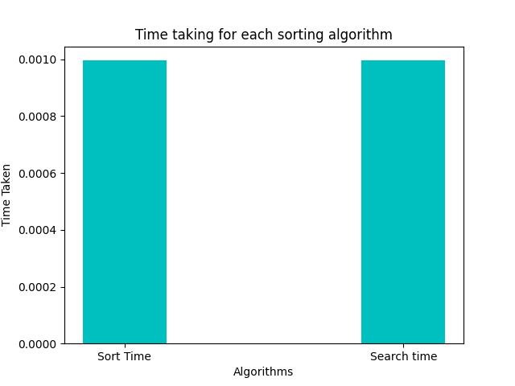
Visualizations

Slide 5
Discussions
Binary Search is another option: efficient in searching through large amount of data
Sorting medical records is another domain where the chosen structure could prove useful

Slide 6
Thank you

